Slide 1




RAM (32G)
RAM (8G)
Data
CPU
GPU
EXE/.out
Shader
Linker
Linker
Compiler
Compiler
Source Code C++
Source Code GLSL, HLSL, SPIR V

Slide 2
Web client
JavaScript
Middleware
C#
Database
SQL

Slide 3
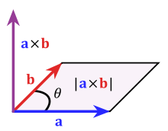
xyz
xyz
xyz
Triangle
xyz
xyz
000

